Slide 1
IT programme Computer Equipment Specialist
Vilnius Vocational Training School of Railway and Business Services
Trainer teacher Adomas Pakalnis

Slide 2
IT hardware tuner program
The purpose of the program is to prepare the proficient computer tuner, acquainted with the history of computer software and hardware, a variety of components, component compatibility, structure, logical structure, principles of operation, malfunctions and their elimination.
3-year learning program
4-month practice in the company

Slide 3
IT hardware tuner program
In the theoretical lessons the aspiring hardware tuners are taught:
Profession practice knowledge and IT
Economics and business
Professional foreign languages
Communication psychology and professional ethics
Lithuanian language culture and professional language

Slide 4
Advantages and disadvantages
Advantages
Disadvantages
Demand among students
Demand in the labor market
Career opportunities
Lack of modern equipment
Men only
Teaching in large groups

Slide 5
Computer software
Application software (MS office, etc.)
Testing programs
Virtual machines
Operational systems. Instalation.

Slide 6
Computer hardware component
Computer parts settings and structure analysis
IT hardware history
Computer gathering
Computer assembling theoretical aspect

Slide 7
Operating system
Type of operating system
Windows operating system
Linux operating system
Server operating systems

Slide 8
MS Office programs
Text editing with MS Word
Working with MS Excel spreadsheet
Create presentations with MS PowerPoint
Working with e-mail in MS Outlook
Creating databases with MS Access

Slide 9
Peripherals devices
Peripherals overview
Printers, types
scanners
Plotter
monitors
Other peripherals

Slide 10
IT Systems Service
Computer assembling
Computer repair
Soldering
Software installation
Software testing
Remote working

Slide 11
Computer networks
Computer networks and systems
Network settings (IP, DNS, gateway, mask)
Computer network equipment
Network Diagnostics commands (ipconfig, tracert, ping)

Slide 12
Computer network administration
Network charts Plotting
Application virtualization with Cisco tracker
Computer network model OSI
Working with the Windows Server operating system

Slide 13
Disk drives
HDD and SSD
CD Types
USB HDD and key
Raid

Slide 14
Theoretical subjects
Microprocessors
Mathematical Logic

Slide 15
Common subjects
Economics
Civil safety
Work safety
English language
Physical education

Slide 16
Subjects, recommended for the new program
IT system maintenance
Hardware and peripherals
Computer software
Computer network and management
Introduction to the speaciality
Introduction to the labor market
Common subjects

Slide 17
Learning resources
Computer class
Computers for the repair
Computers for the software installation
Software
Tools: screwdrivers, tweezers, pliers, network and voltage testers

Slide 18
Learning resources
Soldering equipment
As much as possible various hardware for repair
Business partners. Opportunities to practice in their premises

Slide 19
Practice
Practice duration: 600 hours (75 days)
Twice longer practice span is recommended for the new program

Slide 20
Practice companies

Slide 21
The advantage of the practice in the companies
Practical work experience
Working climate
A more serious approach to the learning and working process

Slide 22
Exams
100 theoretical test questions from various subjects
Various practical tasks (computer assembling, installation, testing, etc.)

Slide 23
Evaluation forms
Test evaluation by the amount of the correctly answered questions:
95–100 - mark 10
40-45 - mark 4
Individual practical part assessment according to the accuracy of every accomplished part.

Slide 25
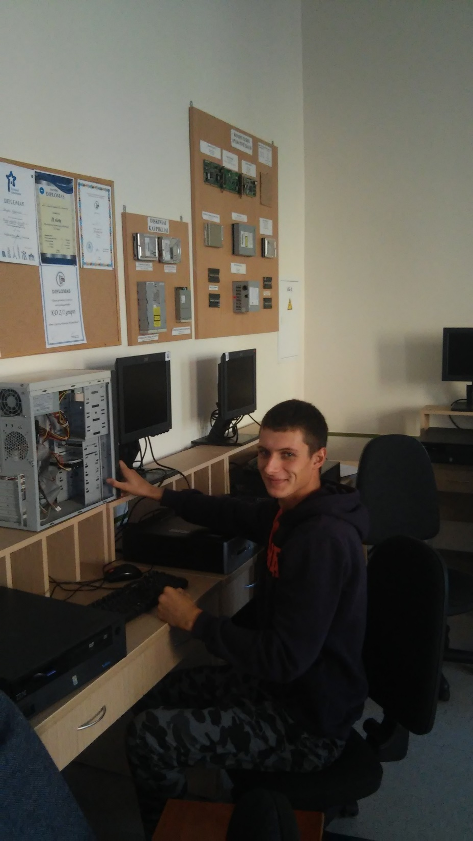

Slide 26
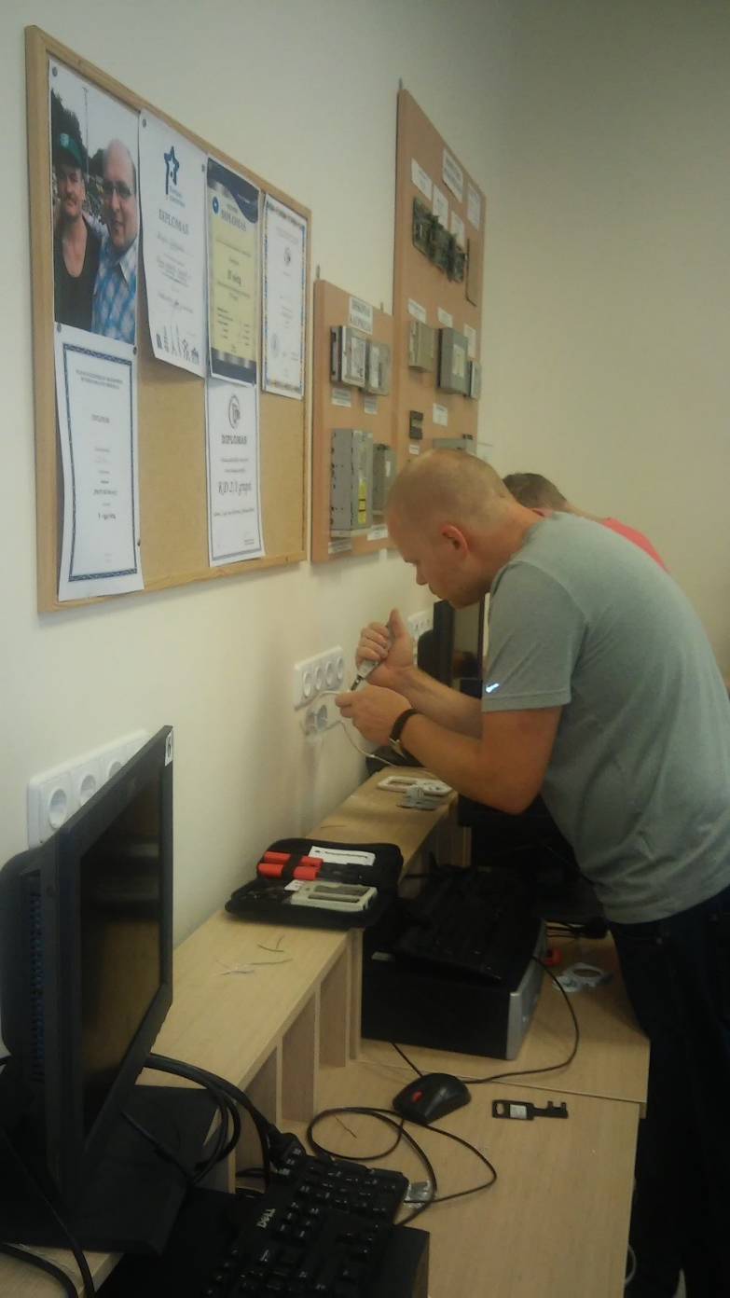

Slide 27
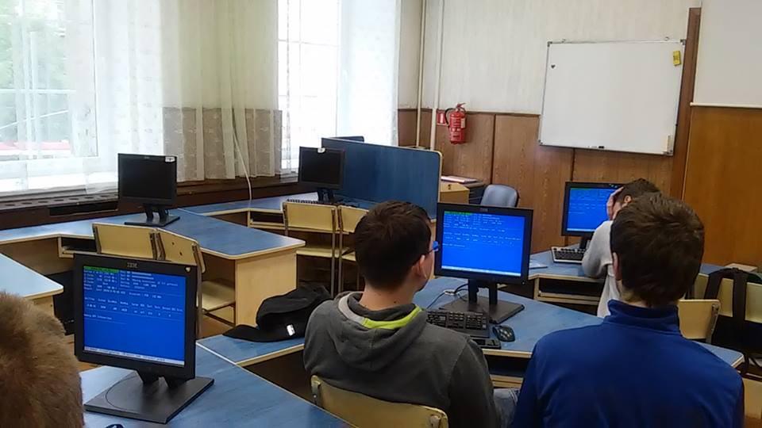

Slide 28
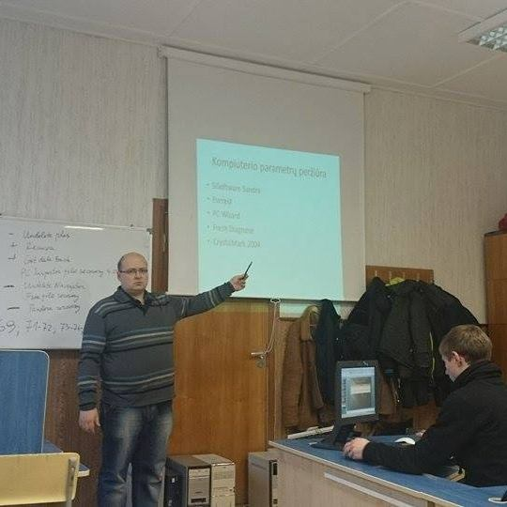

Slide 29
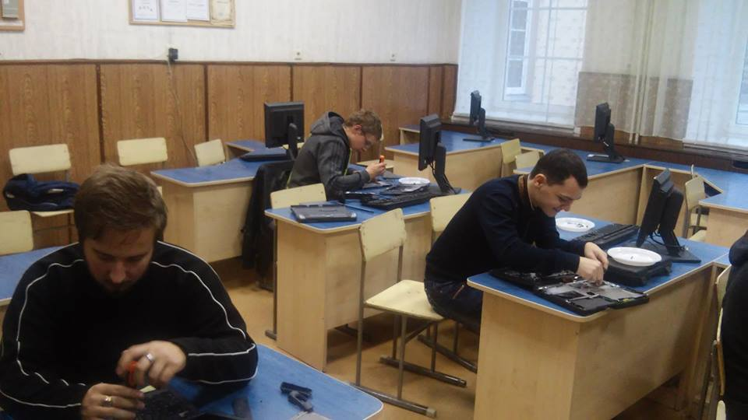

Slide 30
Questions?

